Slide 1
IMDB-Sentiment Analysis of 2022 Movies based on User-Reviews
ENSF-612 Course Project
Presentation 3
Samuel Sofela
Sam Rainbow
Christopher DiMattia
April 6th, 2023

Slide 2

Abstract - Context and Objective
Context
Sentiment analysis is one of the most exciting and challenging fields
Sentiment analysis has immense potential because of the sheer volume and quality of text information that our society produces
One of NLPs foremost challenges is being able to extract a sentiment (positive, neutral or negative) from a piece of text and
Objective
The objective of this project is to create a model that can successfully predict the sentiment (positive, neutral, negative) of a movie review
A secondary objective is to understand which NLP features are the most important for NLP ML models.

Slide 3
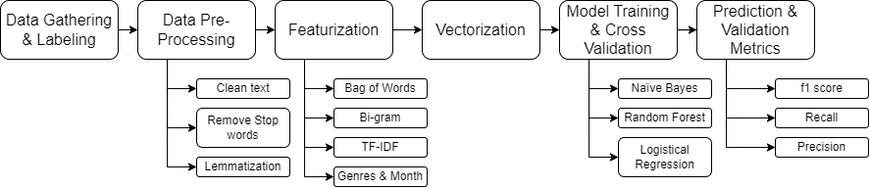
Abstract - Method
Method
Gathering data from IMDb’s website via web scraping
Manually label 1000 reviews by assigning a sentiment to them
Pre-process the data to prepare it for input into a ML model
Create a ML model by training the model on the preprocessed text data and their labeled sentiment
Perform cross validation to tune hyper parameters
Analyze and compare the models and input features to understand which model and feature set is best
Understand and analyze misclassification

Slide 4
Abstract - Results and Conclusion
Result: F1-scores
 | Naive Bayes | Random Forest | Logistic Regression
Bag of Words | 0.651 | 0.548 | 0.648
 | Bag of Words | TF-IDF | Bi-gram | Combined
Naive Bayes | 0.651 | 0.705 | 0.615 | 0.649
 | Naive Bayes | Random Forest | Logistic Regression
TF-IDF | 0.705 | 0.542 | 0.679
Conclusion
Combination of Naive Bayes with Tf-IDF outperformed other models
Hyper parameter
smoothing = 0.5
Results:
F1-score: 0.705; Recall: 0.701; Precision: 0.711

Slide 5

Introduction - Motivation & Background
The film industry invests large amounts of money creating movies with few methods indicating the success of a movie or not
One main indication of success happens in pre-screenings from movie critics which doesn’t always accurately predict the average users sentiment. It is also difficult to capture and summarize sentiment from many critics efficiently.

Slide 6
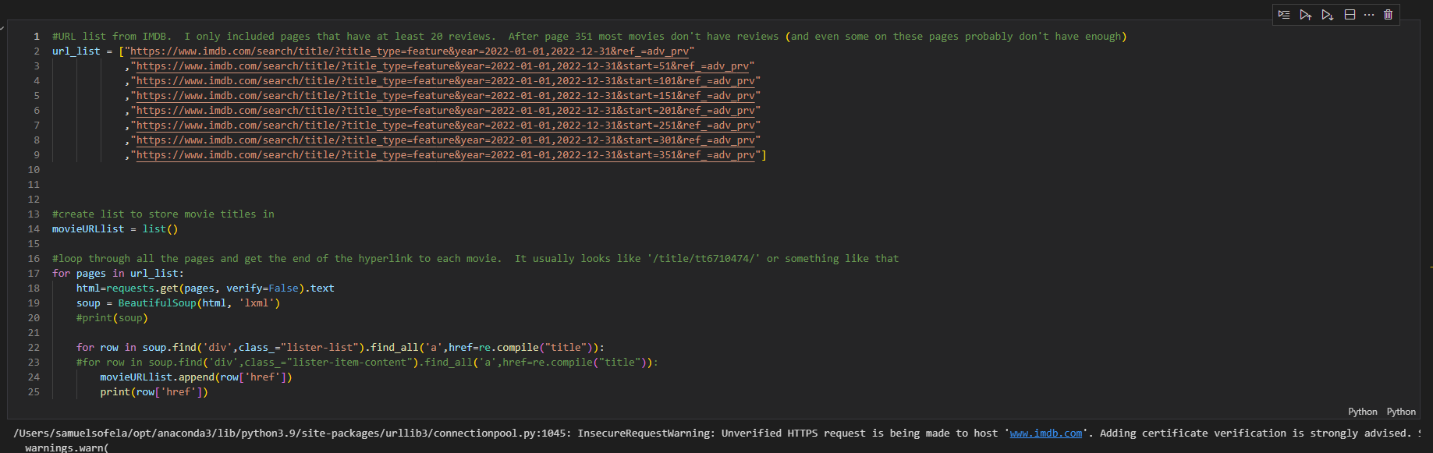
Results - Data Collection - Approach
The approach to collect and label the data was two-fold:
Scrap IMDb with BeautifulSoup to obtain all relevant data (review title, review content, month of release date & genre of movie)
Manually label the data as positive, negative or neutral. User ratings were hid while manual labeling
25 reviews for 40 movies were collected (1000 reviews total)

Slide 7
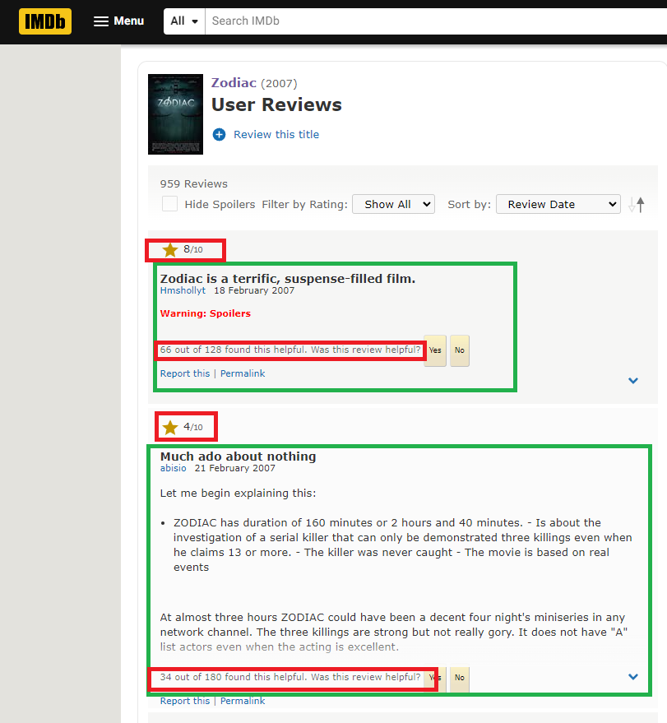
Results - Data Collection - Approach
Most helpful reviews were used to avoid troll reviews and ensure high quality reviews (substantial content)
May introduce bias
May help strengthen the model with better quality data depending on the final purpose of the model (review critics or reviewing entire population)
Target variable is combination of Review Title and Review Content
Data was collected from 2022 movies to have the most recent data

Slide 8
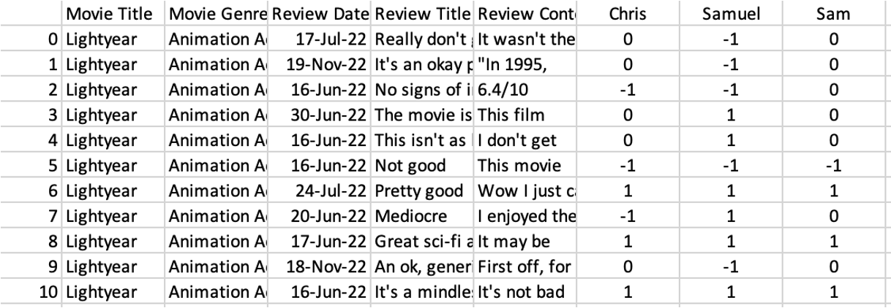
Results - Data Collection - Approach
All reviews were labelled into 3 sentiments: positive(1), neutral (0) and negative(-1)
Each member labelled 1000 reviews.
2 metrics used to evaluate quality of labelling
•Percentage Agreement
•Cohen-Kappa

Slide 9
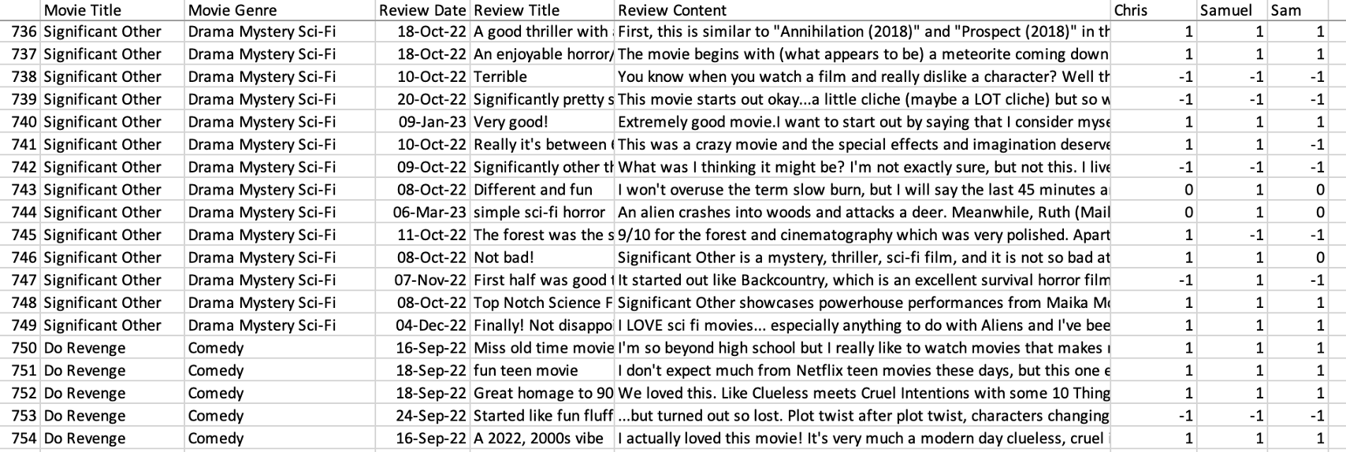
Results - Data Collection - Approach
•2 or more similar rating.
•The rating with the highest count used as final review rating.
2 Similar
Rating
3 Similar
Rating

Slide 10
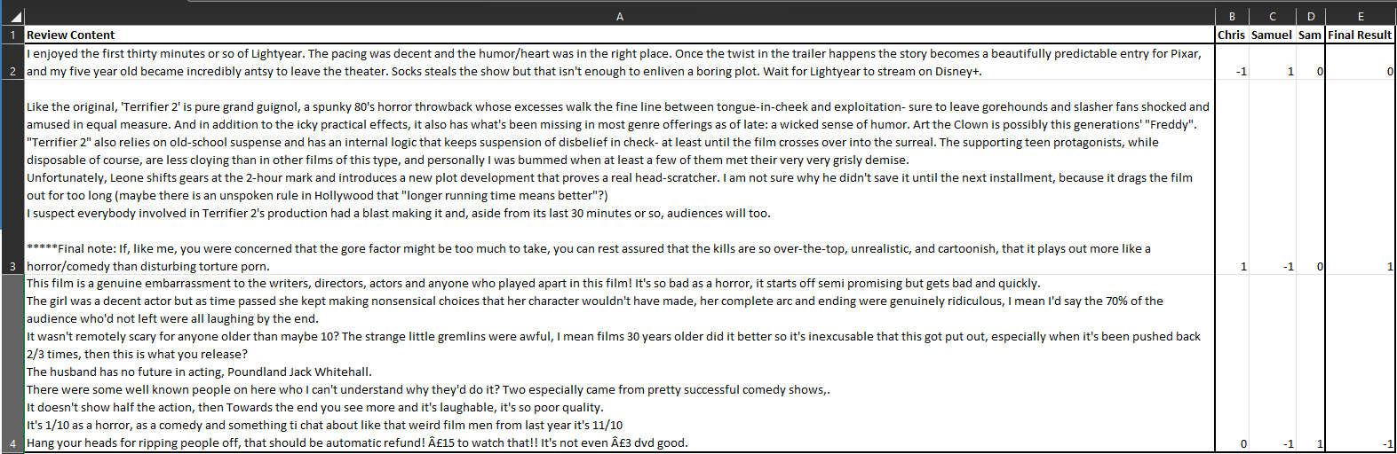
Results - Data Collection - Approach
3 different ratings
14 instances found
Reviews were collectively revisited and rated

Slide 11
Results - Data Collection - Results
1000 reviews were successfully collected using BeautifulSoup and python
Sentiment breakdown
positive: 501
neutral: 170
negative: 329
Agreement Metrics:
Cohen-kappa between rater 1 and 2: 68%
Cohen-kappa between rater 1 and 3: 72%
Cohen-kappa between rater 1 and 3: 66%
Fleiss-Kappa: 69%

Slide 12
Results - Data Preprocessing - Approach
The data was preprocessed with the following techniques
Removed spaces, symbols and punctuation
Changed capital letters to lowercase
Removed stop words
Lemmatized text
Tokenized remaining words
Applied to the review title and review content which were then combined.
Bi-grams were created from the bag of words
TF-IDF was calculated from the bag of words
All inputs (bag of words, bi-gram, TF-IDF, genre and month) were vectorized
Vectorization was accomplished with PySpark’s CountVectorizer instead of PySpark’s HashingTF

Slide 13
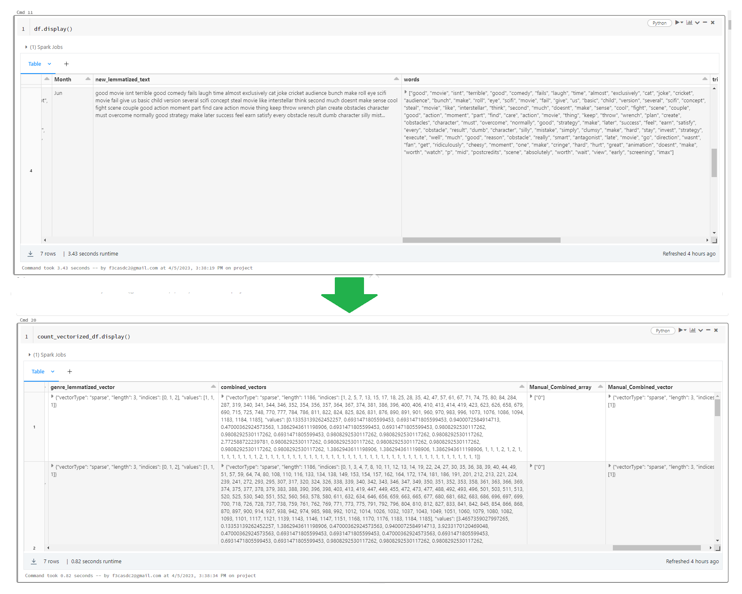
Results - Data Preprocessing - Results

Slide 14
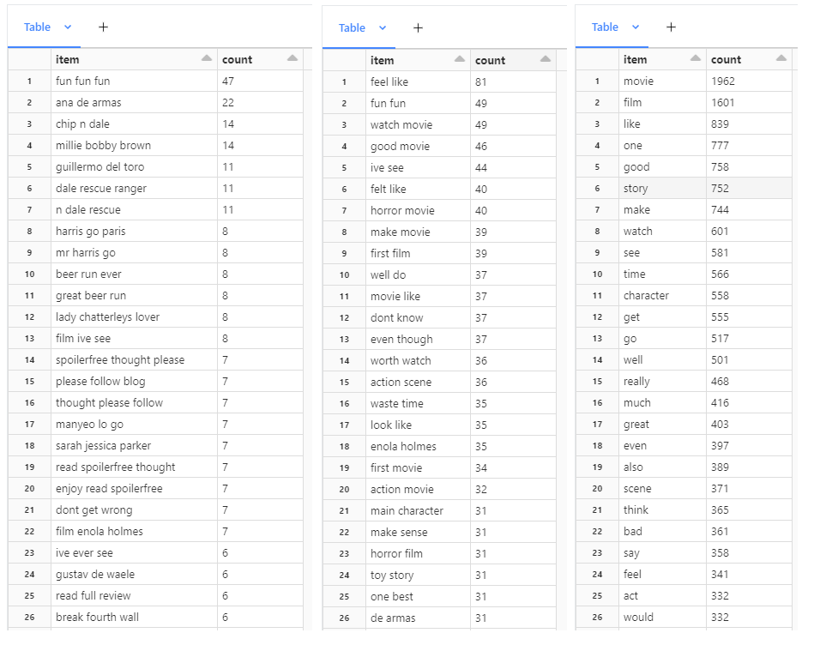
Results - Data Preprocessing - Results
Feature | Num of Features
bag of words | 11,604
bi-gram | 77,880
TF-IDF | 11,604
genre | 17
month | 12

Slide 15
Results - Hyper Parameters - Approach
Five fold cross validation was used for hyper parameter optimization.
A logarithmic range (0, 0.1, 1, 10, 100 or equivalent) was used as a first guess for hyper parameters. After locating the highest f1 score the range is narrowed around the highest values.
For Naive Bayes the only hyper parameter that was changed was alpha. Multinomial NB was chosen because the data is text data which is spare.
For Random Forest the amount of trees and maximum tree depth were the varied hyper parameters.
For Logistic Regression the only hyper parameter was Alpha. L2 regularization was used for all models because it is assumed there is not a small concentration of important features.
The approach was to optimize testing was as follows:
Test multiple models on “bag of words” feature set to identify the best model
Apply that model on all feature sets to identify which feature set is best
Rerun the models on the best feature set to try and maximize f1 score

Slide 16
Results - Bag of Words w/ Random Forest
Random Forest Classifier : Bag of Words
Parameters tuned:
Number of trees
Maximum Depth
Best Parameter
numTrees = 10; maxDepth = 20;
F1-score = 0.548
Precision = 0.558
Recall = 0.605

Slide 17
Results - Bag of Words w/ Random Forest
Hyper Parameters Tuning
F1-Score
Precision
Recall
 | NumTrees
MaxDepth | 5 | 10 | 30 | 50
5 | - | 0.413 | 0.333 | 0.333
10 | - | 0.455 | 0.433 | 0.416
15 | - | 0.540 | 0.508 | 0.486
20 | 0.502 | 0.548 | 0.541 | -
30 | 0.506 | 0.542 | - | -
 | NumTrees
MaxDepth | 5 | 10 | 30 | 50
5 | - | 0.549 | 0.579 | 0.579
10 | - | 0.494 | 0.545 | 0.508
15 | - | 0.614 | 0.566 | 0.541
20 | 0.523 | 0.558 | 0.554 | -
30 | 0.505 | 0.563 | - | -
 | NumTrees
MaxDepth | 5 | 10 | 30 | 50
5 | - | 0.530 | 0.493 | 0.493
10 | - | 0.544 | 0.544 | 0.534
15 | - | 0.605 | 0.595 | 0.578
20 | 0.551 | 0.605 | 0.622 | -
30 | 0.544 | 0.548 | - | -

Slide 18
Results - Bag of Words w/ Naive Bayes
Naive Bayes : Bag of Words
Parameters tuned:
Smoothing
Best Parameter
smoothing = 0.1;
F1-score = 0.651
Precision = 0.652
Recall = 0.649

Slide 19
Results - Bag of Words w/ Naive Bayes
Hyper Parameters Tuning
Smoothing | F1-Score | Precision | Recall
0.00 | 0.206 | 0.341 | 0.339
0.10 | 0.651 | 0.652 | 0.649
0.15 | 0.648 | 0.649 | 0.648
0.20 | 0.646 | 0.645 | 0.646
0.50 | 0.639 | 0.662 | 0.629
1.00 | 0.626 | 0.679 | 0.650
10.00 | 0.333 | 0.493 | 0.579
20.00 | 0.326 | 0.490 | 0.579

Slide 20
Results - Bag of Words w/ Logistic Regression
Logistic Regression : Bag of Words
Parameters tuned:
alpha
Best Parameter
alpha = 0.001;
F1-score = 0.648
Precision = 0.697
Recall = 0.673

Slide 21
Results - Bag of Words w/ Logistic Regression
Hyper Parameters Tuning
alpha | F1-Score | Precision | Recall
0.0001 | 0.641 | 0.691 | 0.661
0.001 | 0.648 | 0.697 | 0.673
0.005 | 0.643 | 0.693 | 0.667
0.01 | 0.636 | 0.686 | 0.660
0.1 | 0.634 | 0.689 | 0.664
1 | 0.601 | 0.672 | 0.569
10 | 0.429 | 0.544 | 0.544

Slide 22
Results
Result- Naive Bayes has the best score and
 | Naive Bayes | Random Forest | Logistic Regression
Bag of Words | 0.651 | 0.548 | 0.648

Slide 23
Results - Bi-gram w/ Naive Bayes
Naive Bayes : Bi-gram
Parameters tuned:
Smoothing
Best Parameter
smoothing = 7;
F1-score = 0.615
Precision = 0.608
Recall = 0.646

Slide 24
Results - Bi-gram w/ Naive Bayes
Hyper Parameters Tuning
Smoothing | F1-Score | Precision | Recall
0 | 0.168 | 0.112 | 0.334
0.1 | 0.193 | 0.649 | 0.252
1 | 0.386 | 0.587 | 0.387
7 | 0.615 | 0.607 | 0.646
10 | 0.573 | 0.578 | 0.613

Slide 25
Results - Combined w/ Naive Bayes
Naive Bayes : Combined
Parameters tuned:
Smoothing
Best Parameter
smoothing = 0.5;
F1-score = 0.649
Precision = 0.648
Recall = 0.653

Slide 26
Results - Combined w/ Naive Bayes
Hyper Parameters Tuning
Smoothing | F1-Score | Precision | Recall
0 | 0.200 | 0.137 | 0.370
0.1 | 0.627 | 0.642 | 0.617
0.5 | 0.649 | 0.648 | 0.653
1 | 0.615 | 0.658 | 0.654
10 | 0.328 | 0.530 | 0.465

Slide 27
Results - TF-IDF w/ Naive Bayes
Naive Bayes : TF-IDF
Parameters tuned:
Smoothing
Best Parameter
smoothing = 0.5;
F1-score = 0.705
Precision = 0.711
Recall = 0.701

Slide 28
Results - TF-IDF w/ Naive Bayes
Hyper Parameters Tuning
Smoothing | F1-Score | Precision | Recall
0.0 | 0.218 | 0.559 | 0.347
0.2 | 0.696 | 0.696 | 0.698
0.5 | 0.705 | 0.711 | 0.701
0.6 | 0.703 | 0.709 | 0.698
0.8 | 0.702 | 0.710 | 0.698

Slide 29
Results - Best Performing Feature Set
Summary: Best performing hyper parameter
 | Results
Model | F1-score | Precision | Recall
Bag of Words | 0.651 | 0.652 | 0.649
Bigram | 0.615 | 0.608 | 0.646
Combined | 0.649 | 0.658 | 0.653
TF-IDF | 0.705 | 0.711 | 0.701

Slide 30
Result
Result: F1-scores
 | Naive Bayes | Random Forest | Logistic Regression
Bag of Words | 0.651 | 0.548 | 0.648
 | Bag of Words | TF-IDF | Bi-gram | Combined
Naive Bayes | 0.651 | 0.705 | 0.615 | 0.649

Slide 31
Results - TF-IDF w/ Logistic Regression
Logistic Regression : TF-IDF
Parameters tuned:
Alpha
Best Parameter
Alpha = 0.008;
F1-score = 0.679
Precision = 0.701
Recall = 0.739

Slide 32
Results - TF-IDF w/ Logistic Regression
Hyper Parameters Tuning
alpha | F1-Score | Precision | Recall
0.005 | 0.673 | 0.695 | 0.732
0.008 | 0.679 | 0.701 | 0.739
0.009 | 0.678 | 0.728 | 0.739
0.01 | 0.675 | 0.725 | 0.735
0.011 | 0.672 | 0.722 | 0.732

Slide 33
Results - TF-IDF w/ Random Forest
Random Forest : TF-IDF
Parameters tuned:
Number of Trees
Max Depth
Best Parameters
Number of trees = 30 Max Depth = 15
F1-score = 0.542
Precision = 0.578
Recall = 0.622

Slide 34
Results - TF-IDF w/ Random Forest
Hyper Parameters Tuning
Num of Trees | Max Depth | F1-Score | Precision | Recall
30 | 5 | 0.399 | 0.586 | 0.532
50 | 10 | 0.454 | 0.564 | 0.564
10 | 15 | 0.531 | 0.612 | 0.605
30 | 15 | 0.542 | 0.578 | 0.622
50 | 15 | 0.496 | 0.556 | 0.591

Slide 35
Results and Conclusion
Result: F1-scores
 | Naive Bayes | Random Forest | Logistic Regression
Bag of Words | 0.651 | 0.548 | 0.648
 | Bag of Words | TF-IDF | Bi-gram | Combined
Naive Bayes | 0.651 | 0.705 | 0.615 | 0.649
 | Naive Bayes | Random Forest | Logistic Regression
TF-IDF | 0.705 | 0.542 | 0.679

Slide 36
Results - Hyper Parameters & Features - Results
It appears that the best model was Naive Bayes with TF-IDF
This result implies that focusing on the importance of words help model performance the best
Combining features did not seem to provide improvements in f1 score, however it increased training time by many magnitudes
Precision and recall were relatively similar throughout all model runs with a few exceptions. This was most likely due to the fact the model was optimizing for f1 score
Bi-gram performed the worst which implies that the tradeoff between some context and a decrease in feature concentration is not worth it

Slide 37
Results - Misclassifications - Approach
Use the best model Naive Bayes with TF-IDF features and predict the sentiment of the user review
Determine which predictions are misclassified by comparing our combined rating to the prediction rating from the model and look for discrepancies
Analyze why the model may be misclassifying these reviews
Contradicting context?
Complex literary tools or words?

Slide 38
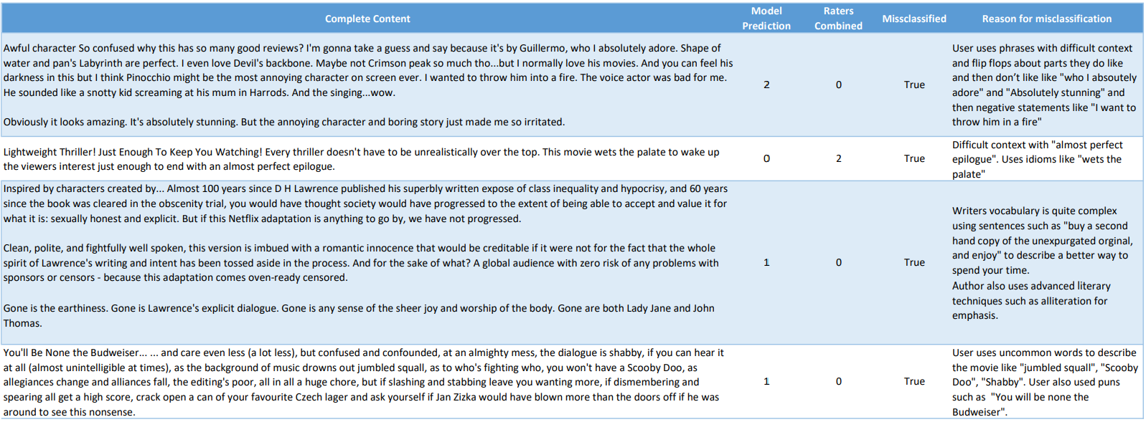
Results - Misclassifications - Results
The
117 out 271 reviews of the testing set were incorrectly predicted by the model ~ 57% accuracy

Slide 39
Results - Conclusions
Conclusions
Model was generally successful with an f1-score of 0.705 despite only have 1000 data points
Amongst the simpler models Naive Bayes seems to be the strongest model
Provides the highest f1 score
Runs the fastest (best able to scale)
Hyper parameter tuning was least impactful
Working with a balanced data set is important because using weighted validation scores diminishes the value of overrepresented data (wasted time collecting and labelling)
More than 1000 records will likely significantly improve validation metrics. When running smaller sets the results decreased drastically, so it is implied 1000 records it not close to the point of diminishing returns
Minimal contextual information did not help f1 score (bi-gram)
Combining multiple features did not significantly help f1 score
Misclassification was common due to ambiguity of many reviews

Slide 40

Questions?

